Slide 1
Managing Azure for Citrix Admins November 30, 2017

Slide 2

Mike Nelson @nelmedia
Cloud Architect with Zerto
Citrix CTP since 2013
CUGC Content Committee
Microsoft MVP C&D
Microsoft Azure Advisor
VMware vExpert

Slide 3



Slide 4
Topics
XAE, XDE, and Azure
Key Azure Concepts
The Portal & PowerShell
Azure Services & Tools
Notes:
Can and will also have Netscaler as a Service and StoreFront as a Service

Slide 5


Delivering and Optimizing Citrix from Microsoft Azure
Marius Sandbu & Dave Brett

Slide 6
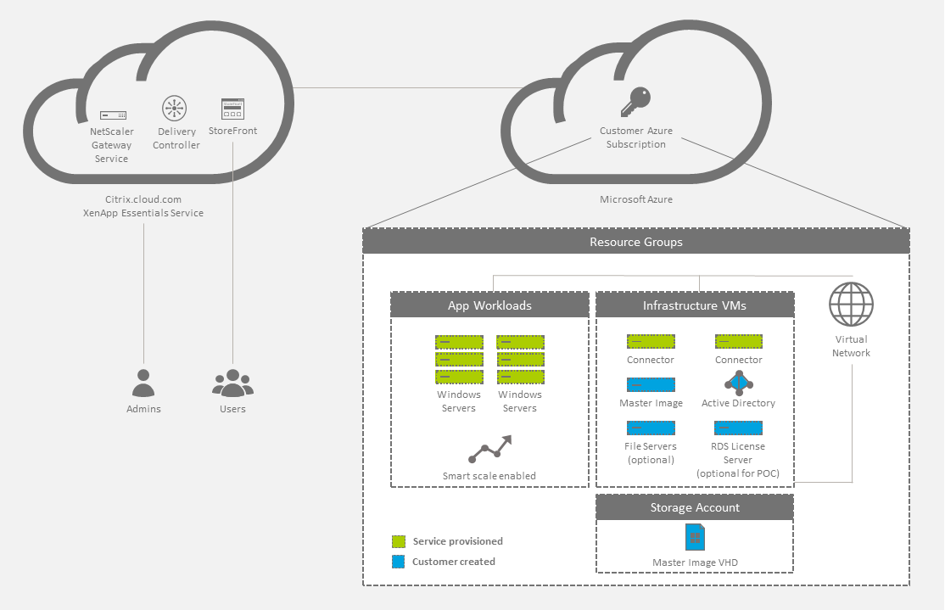

XenApp Essentials

Slide 7
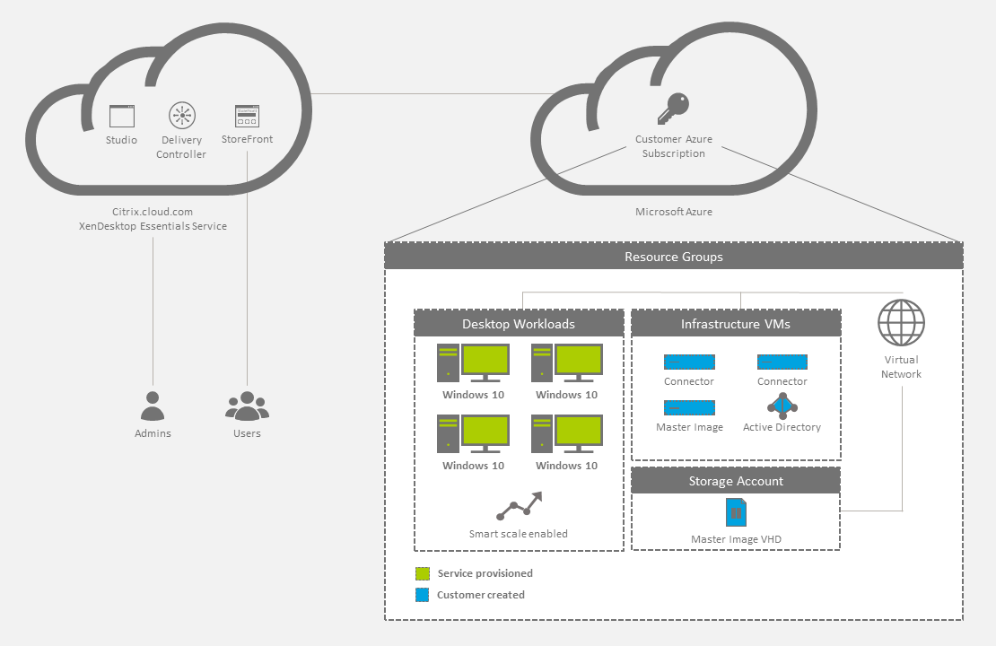
XenDesktop Essentials

Slide 8
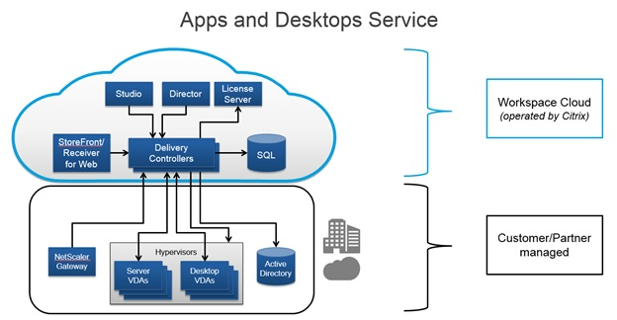

Slide 9
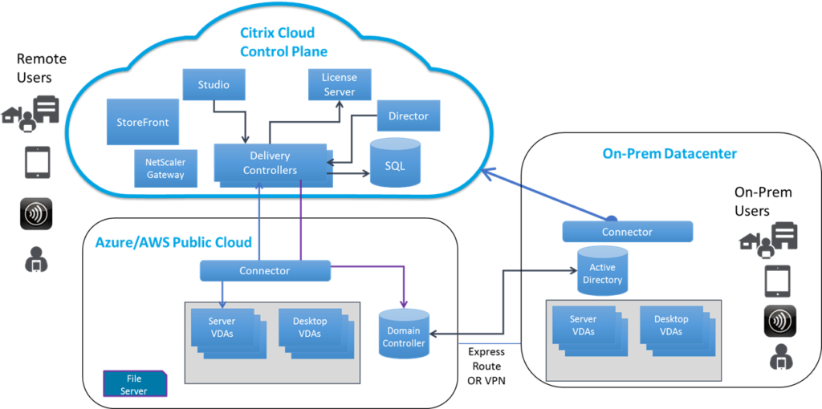

Slide 10
Connectivity
Tenant
Limits
Manage
Portal
RESTful API’s
Resource Manager (ARM)
Resource Groups
Provisioning
Logical groupings
Active Directory (AAD)
Identity Management
RBAC
Lifecycle
Users, groups, devices, etc.
Subscription
Direct Internet
ExpressRoute
SD-WAN
VPN
EA
VS (IDE)
Orchestration

Slide 11
Azure Resource Manager
Application Lifecycle Container
Declarative solution for Deployment and Configuration
Consistent Management Layer
Fading Fast… ASM

Slide 12
Resource Groups
Tightly coupled containers of multiple resources of similar or different types
Every resource *must* exist in one and only one resource group
Resource groups can span regions
RESOU
R
CE G
R
OUP

Slide 13
Coupling for Resources
Resource Group is a unit of management
Lifecycle: deployment, update, delete, status
Identity: resources can talk to each other
→ Grouping: Metering, billing, quota: applied & rolled up to group

Slide 14
Resource Group Lifecycle
Question:
Should these resources be in the same group or a different one?
Hint:
Do they have common lifecycle and management?
Answer:
Up to you.

Slide 15
Power of Repeatability
SQL-A
Instantiation of repeatable config.
Configuration → Resource Group
Azure Templates can:
Ensure Idempotency
Simplify Orchestration
Simplify Roll-back
Provide Cross-Resource Configuration and Update Support
Azure Templates are:
Source file, checked-in
Specifies resources and dependencies (VMs, WebSites, DBs) and connections (config, LB sets)
Parametized input/output
Website
[SQL CONFIG] VM (2x)
DEPENDS ON SQL
DEPENDS ON SQL
SQL - A
Website
Virtual
Machines
SQL
C
ONFIG

Slide 16
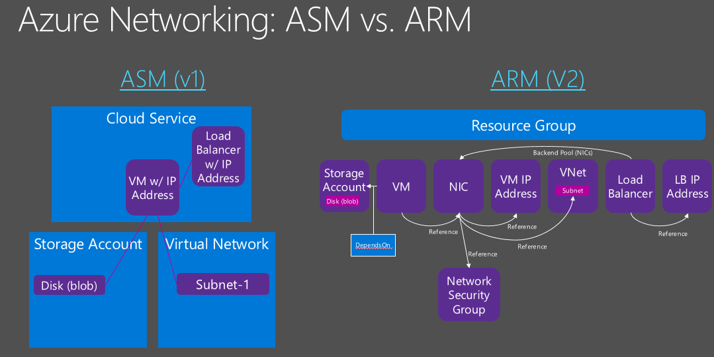
Notes:
Azure Service Management ASM is RDFE version x

Slide 17
Many Ways to Create a VM
Portal
PowerShell
Azure CLI
ARM - ASM Template
REST API
VS SDK
SCCM App Controller
3rd Party Admin

Slide 18
Choosing a VM Size
High Performance Compute
General Purpose
Compute Optimized
Memory Optimized
GPU
A0 – A5 Basic
F1, F2, F4, F8, F16
D11 – D14
NV6, NV12, NV24
A8 – A11
A0 – A7 Standard
D11v2 – D15v2
NC6, NC12, NC24, NC24r
H8, H8m, H16, H16m, H16r, H16mr
D1 – D4
G1 – G5
D1v2 – D5v2
*Not all sizes available in all regions
Notes:
CPU estimated by ACU – Azure Compute Units
Objective: Illustrate the many different possible VM hardware configurations, slotted by purpose.
Notes:
A key takeaway here is that part of provisioning your VM’s is determining the Family/Size that best addresses your needs.
Information Source: https://azure.microsoft.com/en-us/pricing/details/virtual-machines/linux/
General:
A0 – A4 Basic: 1-8 cores, .75-14 GB RAM. Entry-level, economical. Good for dev workloads, dev/test
A0 – A7 Standard: 1-8 cores, .74-56 GB RAM. Entry-level, economical. Supports load-balancing, auto-scaling. Good for dev workloads, dev/test
D1 – D4 (v1): 1 – 8 cores, 3.5 – 28 GB RAM. More powerful CPU than A, feature SSD’s. Also available in Ds (premium storage
D1v2 – D5vs: 1 – 16 cores, 3.5 – 56 GB RAM. Newer-gen D-series, 35% faster CPU than D.
Compute Optimized:
F1 – F16: 1 – 16 cores, 2 – 32 GB RAM. Higher CPU to memory ratio Good for batch-processing, web servers, analytics, gaming.
Memory Optimized:
D11 – D14 (v1): 2 – 16 cores, 14 – 112 GB RAM. Ideal for memory-intensive enterprise applications.
D11v2 – D15v2: 2 – 20 cores, 14 – 140 GB RAM. Ideal for memory-intensive enterprise applications.
GPU
NV6 - NV24: Good for high-end remote visualization, deep-learning, predictive analytics. V series focuses on visualization.
NC6 - NC24/r: Good for high-end remote visualization, deep-learning, predictive analytics. C series focuses on compute. (24r is for tightly-coupled parallel computing workloads with 2nd low-latency, high-throughput NIC)
HPC
A8 – A11: A8 & A10 have 8 cores & 56 GB RAM, A9 & A11 have 16 cores & 112 GB RAM. Entry-level, economical. Good for dev workloads, dev/test
H8, H16, m&r: 8, 16 cores, 56GB – 224 GB RAM. M = high memory, r = RDMA network. Good for risk modeling, seismic & reservoir simulation, molecular modeling, genomic research.
COMING SOON
L-Series: “Storage optimized”

Slide 19
Storage Disks
Standard Storage
Premium Storage
Azure File Storage
Cloud-scale reliable storage
Maximum 500 IOPS, 60 MB per second throughput per disk
Available in all VM Sizes
High-performance, low-latency disk support, ideal for I/O intensive workloads
Maximum 5000 IOPS, 200 MB per second throughput per disk
Only supported in “S” series VMS (DS, DSv2, GS, FS)
Locally redundant storage only
Mount Azure Storage as network share volumes
Can be accessed via SMB 3.0 or REST APIs
Up to 1000 IOPS, up to 60 MB/second throughput per share
Max share size = 5TB, Max file size = 1 TB.
Notes:
Objective: To discuss the available different kinds of storage that can be used by VM disks
Notes:
Data disks have max capacity of 1 TB, but can be striped for larger sizes, up to 64 TB of storage per VM
Azure imposes limits on the number of data disks and amount of bandwidth available, depending on the VM size. (eg F2S = max 4 data disks, F16S = max 32 data disks)
Per-Disk (and Share) IOPS are 8KB operations
Standard Storage
IOPS and Throughput per disk above are for Standard, basic is lower
Entire storage account (not just single disk) has max IOPS of 20,000
Premium Storage
IOPS and Throughput per disk above are for P30, lower for P10, P20
With a GS5, supports up to 80,000 IOPS and 2000 MB/s throughput per VM
Entire storage account has a max total throughput rate of 50 Gbps
No Azure-imposed limit on the number of file shares that can be mounted, no limit on the number of VM’s that can simultaneously mount a File Storage share
Can also be mounted by on-premises clients (Windows) - on prem mounting requires Windows 8 or newer (Server 2012+) and firewall cooperation
No limit on # of files in a share (other than overall share size)

Slide 20
Disks vs Images
OS Images
Microsoft
Partner
User
Base OS image for new Virtual Machines
Sys-Prepped/Generalized/Read Only
Created by uploading or by capture
Disks
OS Disks
Data Disks
Writable Disks for Virtual Machines
Created during VM creation or during upload of existing VHDs.
Notes:
Objective: To present the difference between an OS Image and a VM Disk
Notes:
Images are reference VHDs (almost like a template) for realizing OS Disks for VMs.
VM’s typically have at least 2 disks:
OS Disk (C on Windows), persistent content. SATA access
Temp Storage (D on Windows), SATA access, NOT PERSISTENT (Temp storage only) (Good for TempDB on SQL images, for example)
Additionally, VM’s can have 0->n (depends on characteristics of VM size chosen) data disks
Drive-letter assigned on Windows, SCSI, Persistent
Can be striped for performance
Limit on # determined by VM family/size

Slide 21
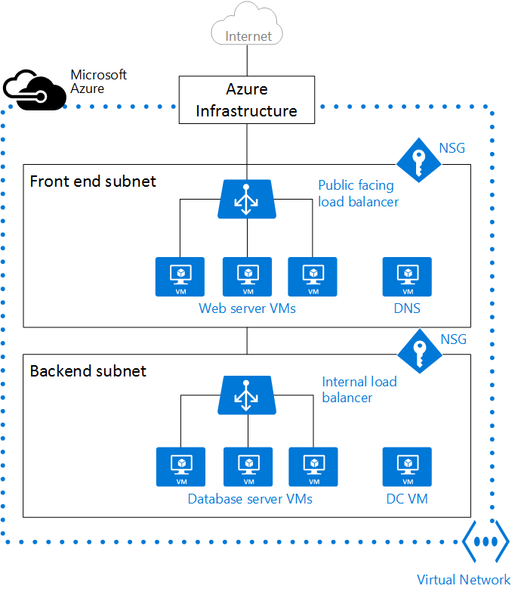
Virtual Networks
“Bring your own network”
Provides security and isolation by creating a private network inside of Azure
Supports:
Defining subnets
“Peering” with other non-overlapping VNETs in the same region
Defining Network Security Groups (ACL rules)
Allows you to create complex and/or sophisticated network topologies around your VM’s
Notes:
Objective: To introduce the concept of Virtual Networks (VNETs) in Azure
Notes:
A VNET is “your private network within the overall Azure network”
Along with the VNET, you can leverage other tools like Load Balancers, Network Service Gateways, Application Gateways, Public IP Addresses, etc.
Peering (new feature) allows 2 VNETs to be maintained as separate resources, but VMs in those VNETs can communicate with each other directly via IP Address.
VNETs can define Network Security Groups, which contain ACL rules that allow or deny traffic to VM instances in a VNET.
NSG’s can be associated with subnets or individual VM instances
Illustration source: https://azure.microsoft.com/en-us/documentation/articles/virtual-networks-overview/

Slide 22
Control Your Spend
https://azure.microsoft.com/en-us/pricing/calculator/
****Different regions, different prices! (http://map.buildazure.com)

Slide 23
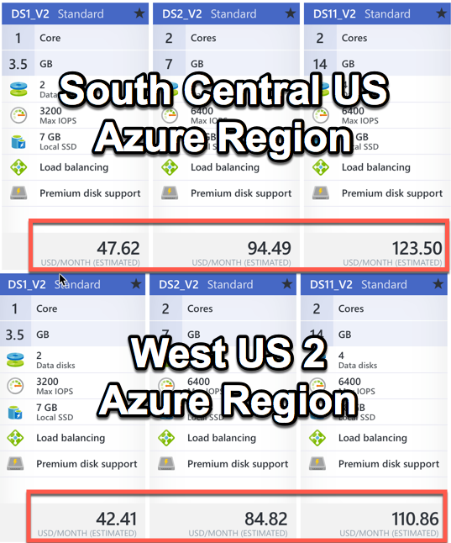

Slide 24
Be Aware of your Limits
https://docs.microsoft.com/en-us/azure/azure-subscription-service-limits
Resource | Default Limit | Max Limit
Cores per sub | 20 | 10,000
VMs per sub (RM) | 20 per region | 10,000 per region
VM total cores (RM) | 20 per region | 10,000 per region
VM per series | 20 per region | 10,000 per region
Resource Groups per sub | 800 | 800
RM API Reads | 15000 per hour | 15000 per hour
RM API Writes | 1200 per hour | 1200 per hour
RM API Request Size | 4194304 bytes | 4194304 bytes
VMs per cloud service (ASM) | 50 | 50

Slide 25
The Azure Portal

Slide 26
Setting Up PowerShell
Framework
Latest 5.5
Cmdlets
Azure Downloads
Keep Current
PowerShellGet
Web Platform Installer
GitHub
Standalone
GitHub Releases
Azure Downloads
Chocolatey
Win10 & 2016 “Automagic”
PowerShell
3.0 is minimum
Beta 6 (GitHub)
5.x is best
PowerShell DSC - Learn It!

Slide 27
PowerShell Management Methods
ASM (Classic) – Built-In access via WinRM
ARM – Requires Config pre or post VM (w/certs)
Internal
Windows Jump Box
Linux OMI Provider via PSRP
SMT
External
RDP / SSH
HTTPS WinRM tcp/5986 – PoSH Remoting (Certs)
SMT

Slide 28
Azure Tools and Services

Slide 29


STAY IN THE KNOW | myCUGC.org
Citrix Centered Forum Threads
Local Groups and Meeting Information
Today’s Webinar and other Recorded Webinars
Technical Blogs from Industry Experts
FOLLOW US ON TWITTER | @myCUGC

